Slide 1
MACHINE LEARNING IN RETAIL STORE

Slide 2
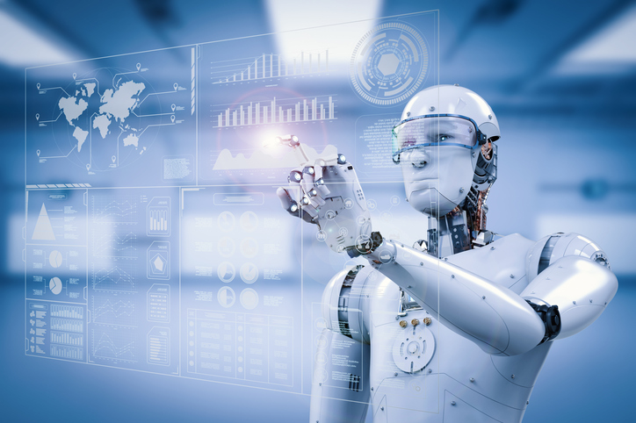
What is Machine Learning
Machine learning is a field of computer science that uses statistical techniques to give computer systems the ability to "learn" with data, without being explicitly programmed.
In real life, machine learning is used in Self Driving Cars, Robots, Google Assistant etc.

Slide 3
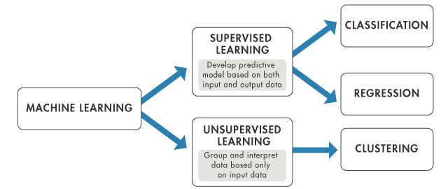
Learning Algorithms

Slide 4
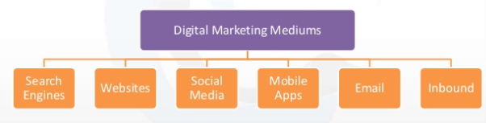
What is Digital Marketing ?
Digital marketing is the promotion of products or services using digital technologies like Internet.

Slide 5
How ML enhance Digital Marketing
The opportunities machine learning present for marketers are virtually unlimited. Here are some of them:
Unlimited Data: With this data, you can adjust your brand’s message based on the most recent consumer behaviors.
Customer Segmentation: ML can be used to identify various segments of your target market. This data can help you create a predictive approach to your customer segmentation, allowing you to lead each customer individually through their purchase history.
Customer Lifetime Value: Your customer lifetime value is calculated based on their purchasing history, their interactions with your marketing campaigns, as well as the actions they take on your platform. ML calculates your customer lifetime value more accurately thus allowing you to optimize your future interactions with them accordingly.

Slide 6
Real time applications
Amazon uses AI and ML for its online store
Netflix uses the predictive analysis tool for better content curation
IBM Watson’s extensive use in the better recommendation for cancer treatments in many healthcare organizations
Walmart uses machine learning based software for anticipating customer needs and providing suitable solutions for them

Slide 7
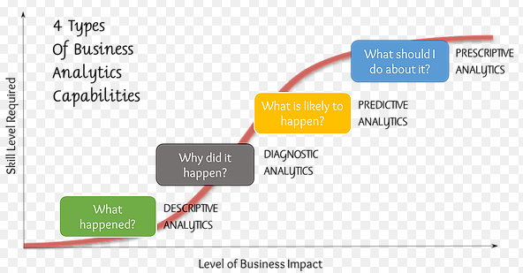
DATA ANALYTICS

Slide 8
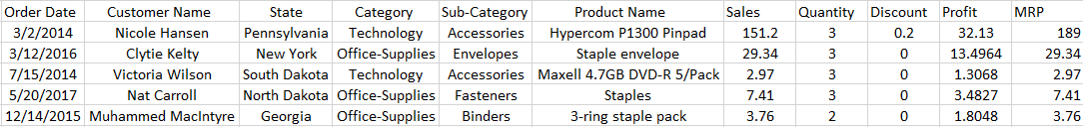
DATASET
The dataset is obtained from the retail-store based in US.
The data has been collected over the period of 4years from 2014-17
There has been a total of 793 customers from 49 different states with 1850 products.
Some of the features available in the dataset are Customer Name, Product Name, Order-Date, M.R.P, Profit, Quantity Sold, Discount.

Slide 9
DESCRIPTIVE ANALYTICS
What is happening now based on incoming data. To mine the analytics, you typically use a real-time dashboard and/or email reports.
Data aggregation and data mining methods organize the data and make it possible to identify patterns and relationships in it that would not otherwise be visible.
Querying, reporting and data visualization may be applied to yield more insight.

Slide 10
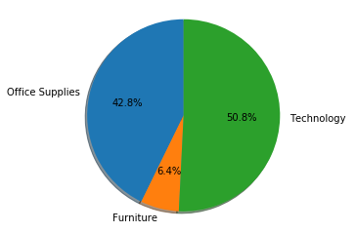
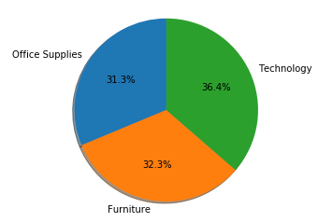
Category wise Analysis
Profit
Sales

Slide 11
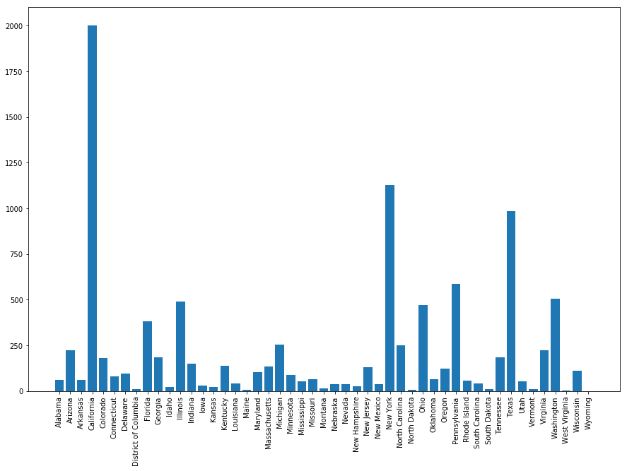
State-Wise Analysis

Slide 12
Digital marketing - Retail Store
The project is to build good models for various marketing activities, exploring the usage of both structured and unstructured data.
The following are the use-cases of the project:
Customer Segmentation
Pricing
Discount Prediction
Profit Estimation
Targeted Marketing
Recommended system
Product Recommendation
Customer Recommendation
Inventory management

Slide 13
CUSTOMER SEGMENTATION
RFM Score
Logistic Regression

Slide 14
Customer Segmentation is the practice of dividing a customer base into groups of individuals that are similar in specific ways relevant to marketing . This is implemented using RFM and Logistic Regression.
Logistic Regression is a classification algorithm. It is used to predict a binary outcome (1 / 0, Yes / No, True / False) given a set of independent variables.
RFM (Recency, Frequency, Monetary) is a very Simple Technique that we can apply to get the super useful analysis for our Customer Segmentation.
Recency (R) : How many days ago was their last purchase?
Frequency (F) : How many times has the customer purchased from our store?
Monetary (M) : How much money has this customer spent?

Slide 15
Marketing efficiency – making it easier to identify your target audience and launch campaigns to the most relevant people
Determine new market opportunities – During the process of grouping your customers into clusters, help you to identify a new market segment, which could in turn alter your marketing focus and strategy to fit.
Better recommendation strategy – Once you have identified the key motivators for your customer, you can recommend your products appropriately.
Customer retention – Using segmentation, marketers can identify groups that require extra attention and those that churn quick, along with customers with the highest potential value.
It can also help with creating targeted strategies that capture your customers attention and create positive, high-value experiences with your products.

Slide 16
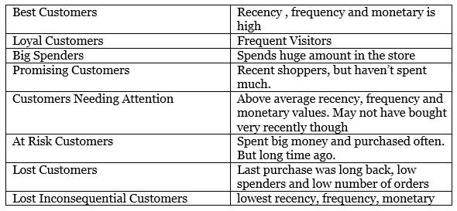
Categories of Customers

Slide 17
PRICING
LOGISTIC REGRESSION
PREDICTIVE ANALYTICS
Discount prediction
Profit estimation

Slide 18
Discount prediction
Logistic Regression is a classification algorithm. It is used to predict a binary outcome (1 / 0, Yes / No, True / False) given a set of independent variables.
The product features like space, state, quantity, sub category and age were considered for predicting the discount. (Predictive Analytics)
Predictive analytics is the use of data, statistical algorithms and machine learning techniques to identify the likelihood of future outcomes based on historical data.
The goal is to go beyond knowing what has happened to providing a best assessment of what will happen in the future.

Slide 19
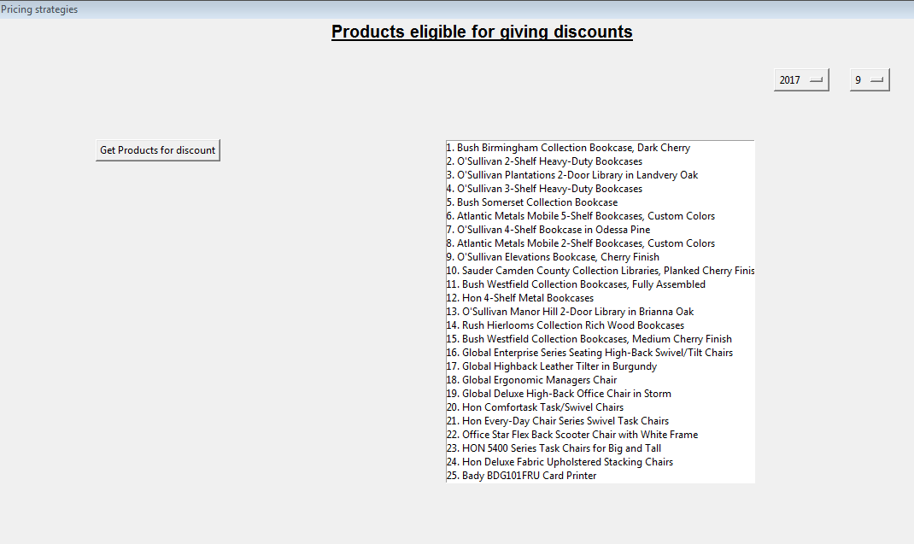

Slide 20
Profit Estimation
It gives ecommerce retailers the right data and information that can be used to set optimal discount/price to the product and stay profitable despite the price fluctuations.
Based on the product profit of last 3 months classified them into Best, Moderate and Worst products.
The retailer can manually give discounts and obtain the profits for a particular category of products.

Slide 21
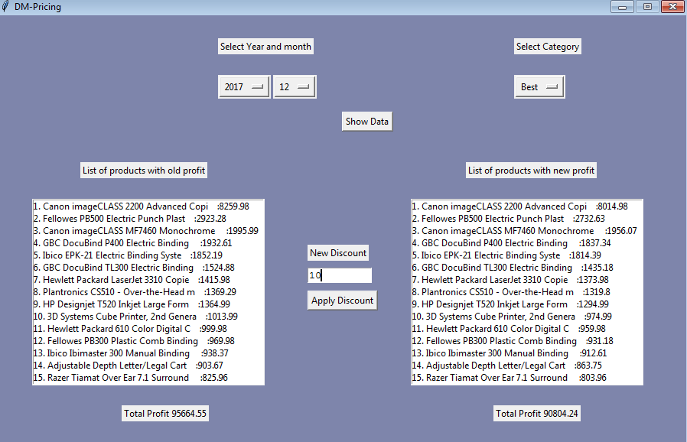

Slide 22
TARGETED MARKETING
PRESCRIPTIVE ANALYTICS

Slide 23
Prescriptive Analytics
Prescriptive analytics is dedicated to finding the best course of action for a given situation.
Prescriptive analytics can also suggest decision options for how to take advantage of a future opportunity or mitigate a future risk, and illustrate the implications of each decision option.

Slide 24
Targeted Marketing is the process of dividing a large market into smaller pieces based on one or more meaningful shared characteristics and they will respond similarly to marketing action.
From the results obtained from Customer Segmentation, customers of different clusters are formed.
Based on the products what they are buying more and making more profits to the company for every customer their interested sub-categories are decided.
The offers are given on their interested products to people in some clusters in products interested by that group by sending E-mails.

Slide 25
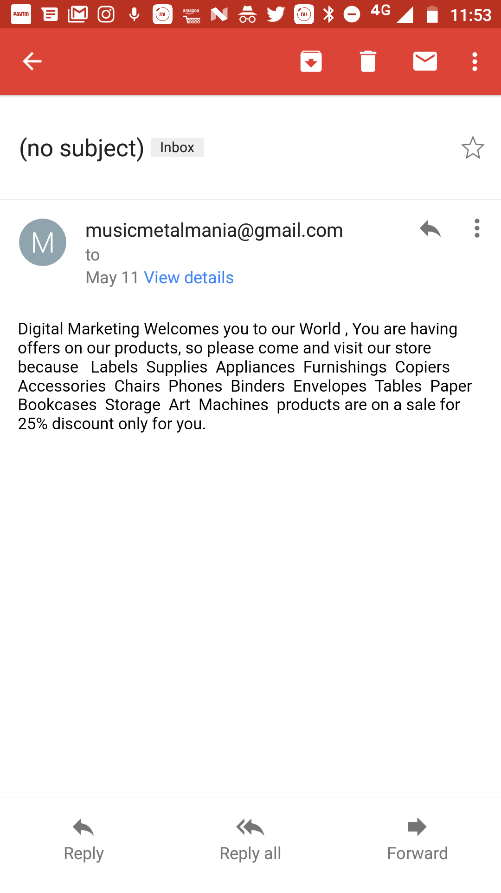

Slide 26
Targeted Marketing has evolved to embrace the 4 R’s –Right Customer, Right Channel, Right Moment and Right Answer.
The Right Person: Identifying the right customer through a combination of internal customer and prospect data.
The Right Channel: Once the right customer has been identified, marketers must use a multi-channel approach to target today’s consumers. As customer go from device to device and use an average of eight channels or more for researches and purchases.
The Right Moment: Customers today are constantly bombarded with marketing messages and advertisements. Cutting through the clutter requires that you serve up the most relevant messages at the right time.
We can get the Right answer when targeted to the right customer, through the right channel, and at the right moment, every customer interaction is an opportunity to strengthen customer loyalty, reduce churn, and boost revenues.

Slide 27
RECOMMENDATION SYSTEM
ASSOCIATION RULE LEARNING
COSINE SIMILARITY
PEARSON CORRELATION
PRODUCT BASED RECOMMENDATION
CUSTOMER BASED RECOMMENDATION

Slide 28
ASSOCIATION RULE LEARNING
Product Based Recommendations :
A Personalized product recommendation isn’t based on an assumption or guess. Recommendations are based on user behaviour. These are items that have been frequently viewed, considered, or purchased with the one the customer is currently considering.
What Amazon does — and what your store can do, too — is utilize the behaviour of customers to make predictions about what future customers will like.
From the result obtained from classification of Products as best, Moderate and Worst products, analysis was done on best products.
Recommendation system generates score for all products taking one product at a time into consideration.
For each product, based on the scores the top five products are recommended.

Slide 29
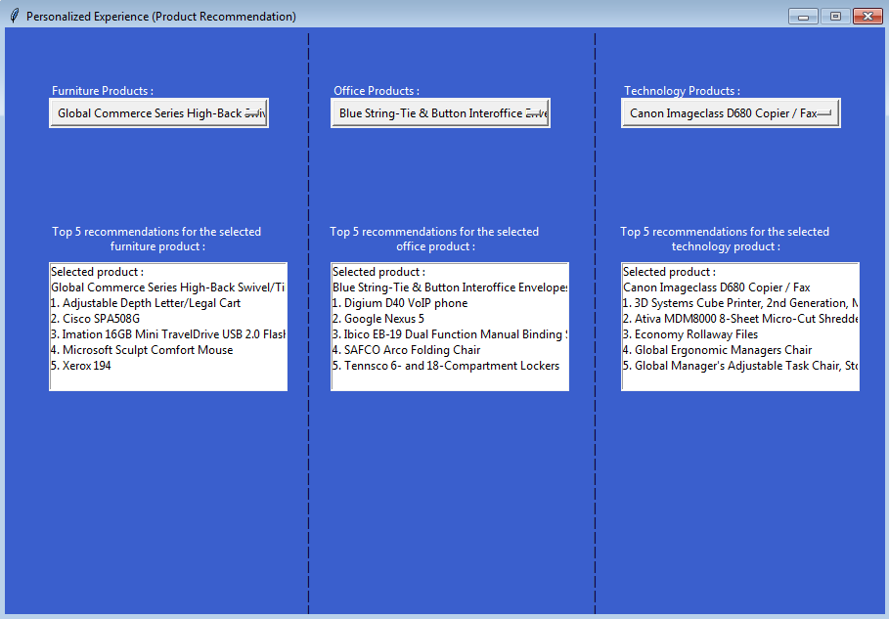

Slide 30
Customer Based Recommendation :
Customer Based Recommendation is a term frequently used in marketing. It is a measure of how products and services supplied by a company meet or surpass customer expectation. Is defined as "the number of customers, or percentage of total customers, whose reported experience with a firm, its products, or its services (ratings) exceeds specified satisfaction goals.
The best customers and best products were considered
Using Cosine Similarity and Pearson Correlation a similarity score is generated
If the score > threshold, compare the purchase pattern and recommended products.

Slide 31
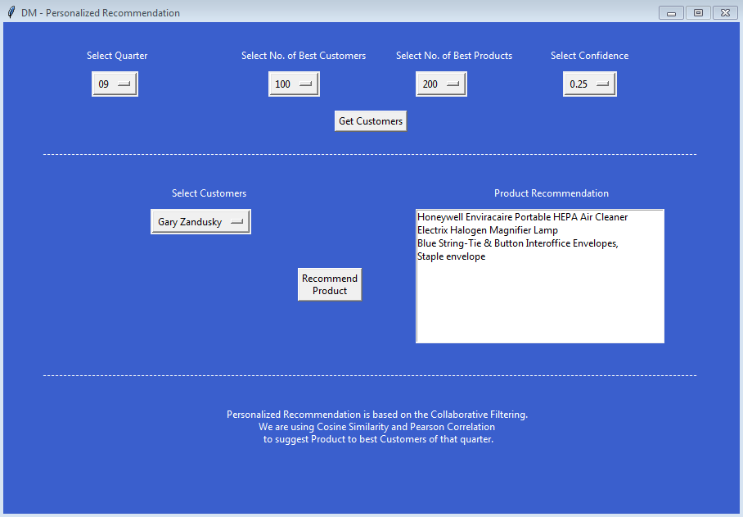

Slide 32
INVENTORY MANAGEMENT
Descriptive Analytics
Predictive Analytics
Linear Regression

Slide 33
Inventory management as an element of supply chain management, includes aspects such as controlling and overseeing ordering inventory, storage of inventory, and controlling the amount of product for sale.
It is also important to maintaining the right balance of stock in your warehouses, too much inventory can trigger profit losses––whether a product expires, gets damaged, or goes out of season.

Slide 34
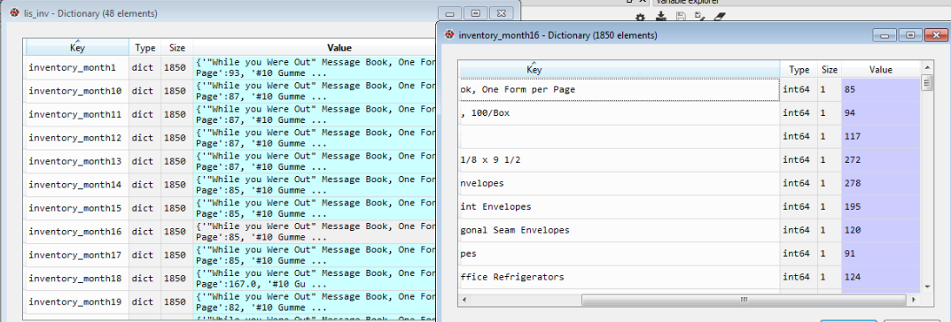
Extracted the pattern of inventory for all products for a period of 48 months.(Descriptive Analytics)
Based on profits and quantity sold of products they are classified as best, moderate, worst and High, Medium, Low respectively.
Inventory was managed by taking above parameters.
Based on product & given date the predicted sales for next 3 months are calculated by using Linear Regression.(Predictive Analytics)

Slide 35
It eliminates human error, companies now operate much more efficiently, without this excessive purchase and dead stock accumulation are the most common issues.
Client has an upper hand over other non-tech savvy owners, such as make real time business decisions, Access inventory information for all channels in a single interface, to approve invoices or purchases while travelling or never worry about you losing your data ever.

Slide 36
Thank you!

